Slide 1
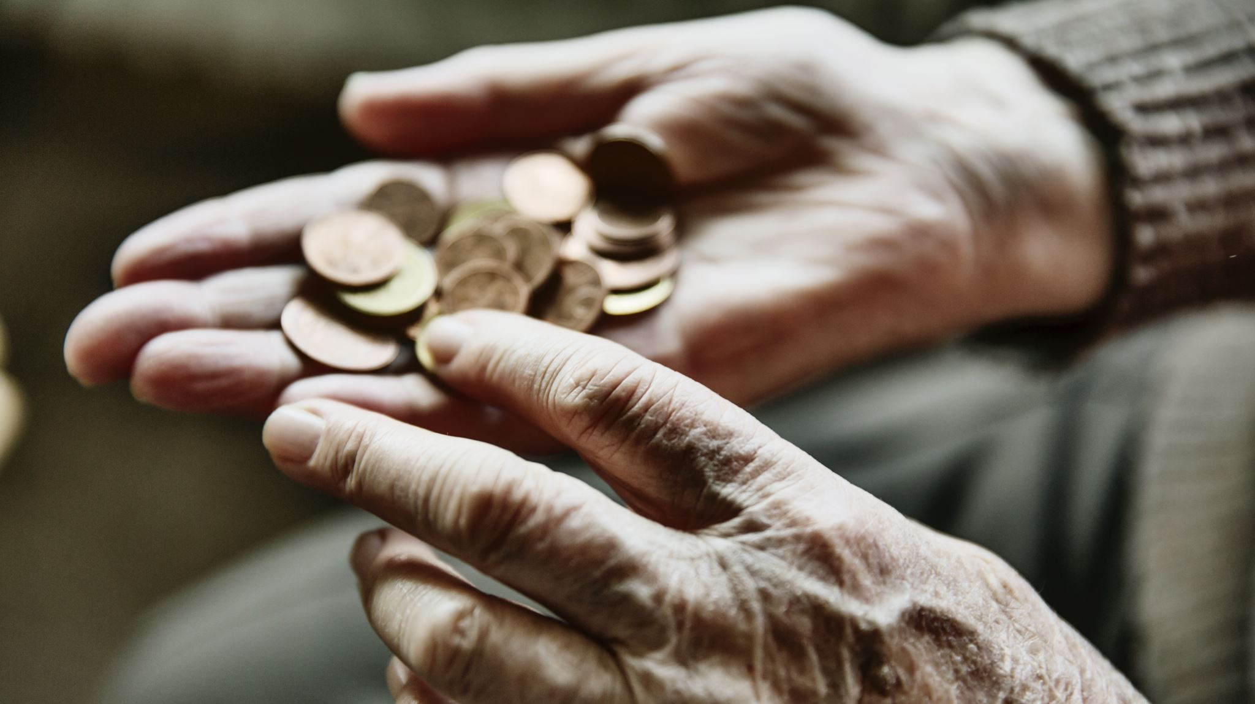
Count the cost
By Follow God Ministries

Slide 2

Discuss Christianity
How would you explain how you practice you Christianity?
  For example:
  Someone from a foreign land found out you were a Christian and they ask what do you?
Misconceptions: Many people reduce Christianity to
    God related activities
    Trying to be a good person
    Telling people to try Jesus
*Error- many people are doing this and still don’t know Christ. Religion not relationship

Slide 3

Salvation- a free gift
Salvation
Romans 10:9 If you confess with your mouth that Jesus is Lord and believe in your heart that God raised him from the dead, you will be saved
Grace
Ephesians 2:8-9 For it is by grace you have been saved, through faith—and this is not from yourselves, it is the gift of God— ⁹ not by works, so that no one can boast.
Philippians 2:12 For it is by grace you have been saved, through faith—and this is not from yourselves, it is the gift of God— ⁹ not by works, so that no one can boast.

Slide 4

Working out your salvation
James 2:14-26
¹⁴ What good is it, my brothers and sisters, if someone claims to have faith but has no deeds? Can such faith save them? ¹⁵ Suppose a brother or a sister is without clothes and daily food. ¹⁶ If one of you says to them, “Go in peace; keep warm and well fed,” but does nothing about their physical needs, what good is it? ¹⁷ In the same way, faith by itself, if it is not accompanied by action, is dead.
¹⁸ But someone will say, “You have faith; I have deeds.”
Show me your faith without deeds, and I will show you my faith by my deeds. ¹⁹ You believe that there is one God. Good! Even the demons believe that—and shudder.

Slide 5
Deeds alone is not what is important to jesus
Matthew 7:21-23
I Never Knew You
²¹ “Not everyone who says to Me, ‘Lord, Lord,’ shall enter the kingdom of heaven, but he who does the will of My Father in heaven. ²² Many will say to Me in that day, ‘Lord, Lord, have we not prophesied in Your name, cast out demons in Your name, and done many wonders in Your name?’ ²³ And then I will declare to them, ‘I never knew you; depart from Me, you who practice lawlessness!’

Slide 6
How to reconcile?
We are saved by faith. God wants us to do something with that faith. Our works are evidence of our faith.
James 2:14-26 Was not our father Abraham considered righteous for what he did when he offered his son Isaac on the altar? ²² You see that his faith and his actions were working together, and his faith was made complete by what he did.

Slide 7
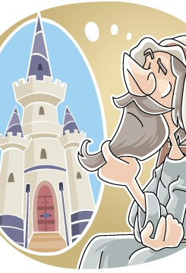
Counting the cost
Luke 14:28
For which of you, desiring to build a tower, does not first sit down and count the cost, whether he has enough to complete it?
Foundational scripture
Matthew 16:24-26
²⁴ Then Jesus told his disciples, “If anyone would come after me, let him deny himself and take up his cross and follow me.
²⁵ For whoever would save his life will lose it, but whoever loses his life for my sake will find it. ²⁶ For what will it profit a man if he gains the whole world and forfeits his soul? Or what shall a man give in return for his soul?

Slide 8
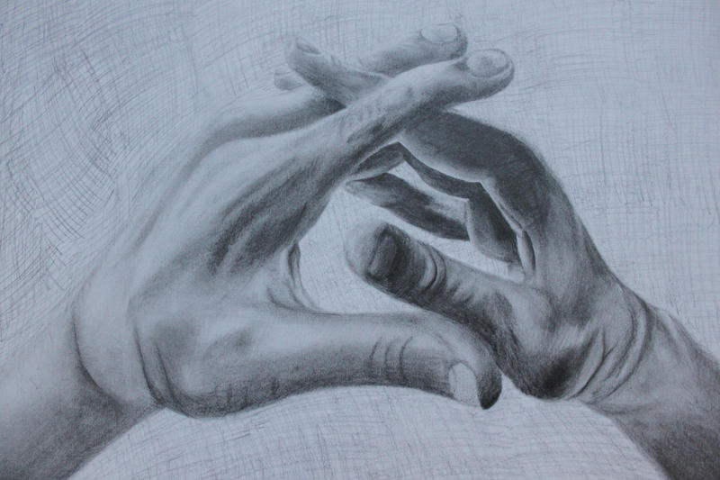

Counting the cost (cont’d)
Luke 14:25-33 Now great crowds accompanied him, and he turned and said to them, “If anyone comes to me and does not hate his own father and mother and wife and children and brothers and sisters, yes, and even his own life, he cannot be my disciple.
Luke 14:33 So therefore, any one of you who does not renounce all that he has cannot be my disciple.
Matthew 19:29 And everyone who has given up houses or brothers or sisters or father or mother or children or property, for my sake, will receive a hundred times as much in return and will inherit eternal life.

Slide 9

Reality of following Jesus
^{Luke 9 57-62}
Now it happened as they journeyed on the road, that someone said to Him, “Lord, I will follow You wherever You go.” And Jesus said to him, “Foxes have holes and birds of the air have nests, but the Son of Man has nowhere to lay His head.”
Then He said to another, “Follow Me.” But he said, “Lord, let me first go and bury my father.” Jesus said to him, “Let the dead bury their own dead, but you go and preach the kingdom of God.”
And another also said, “Lord, I will follow You, but let me first go and bid them farewell who are at my house.” But Jesus said to him, “No one, having put his hand to the plow, and looking back, is fit for the kingdom of God.”

Slide 10
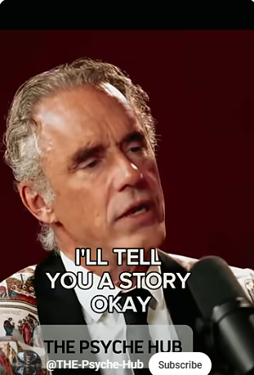
Reality of Christianity (cont’d)
Dr. Jordan B. Peterson
A renowned psychologist, author, and online educator.
Thoughts a being a Christian
https://youtube.com/shorts/kl85ur-2BpA?si=3wqUu5OjCqb-n17a
* narrow road

Slide 11
Laying the foundation
God has the plan for your entire life, even the details
Jeremiah 29:11
¹¹ For I know the plans I have for you,” declares the Lord, “plans to prosper you and not to harm you, plans to give you hope and a future.
Psalm 37
The LORD directs the steps of the godly. He delights in every detail of their lives.
Romans 8:14-17
For all who are led by the Spirit of God are children of God.

Slide 12
Taking the Limits off God
Isaiah 9:6
For unto us a child is born, unto us a son is given: and the government shall be upon his shoulder: and his name shall be called Wonderful, Counsellor, The mighty God, The everlasting Father, The Prince of Peace
What can God do for you??
Attune you ear to His voice
Reveal Himself to you- His character, His heart
Heal you
Teach / train you
Help you gain order and structure in your life- ex: Remove what’s not Him
Reveal identity
Reveal spiritual/giftings callings train you
Inform, lead and guide you in your steps daily
Comfort you and so much more!
*If you don’t allow God to lead, the world will and the ruler of this world is Satan. John 16:11 NLT

Slide 13

Where to Begin
1. Declaration- Surrender to Jesus- Give Jesus your second yes.
2. Submit- Come under the authority, Lordship of Jesus
3. Go after Him. Pursue Him.
  Devotion Time. Starting then maturing and evolving.
  Practice inviting Him into your day. Walk with Him. Talk with Him. Seek, listen, obey.
  4. Rid yourself of sin.
  5. Complete known step that you feel led to take. Getting in the will of God and abiding in Him
  *Know that the holy spirit will lead, teach and bring all things to remembrance for you in this process John 14:26/ Romans 8:14

Slide 14
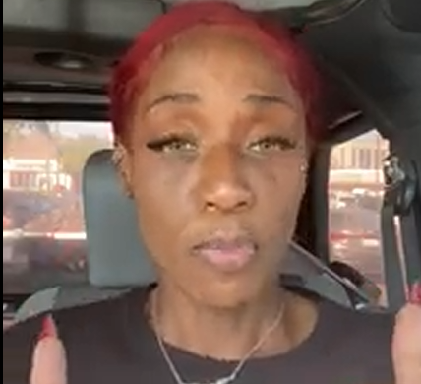
Why important?
God has a plan for you. Created for purpose.
Satan will do everything He can to come against that plan
Watch this short sports analogy to help you understand.
https://youtu.be/d-9WilQlP3s

Slide 15
Reflection
1. Do you do this?
Matthew 16:24-26
²⁴ Then Jesus told his disciples, “If anyone would come after me, let him deny himself and take up his cross and follow me.
2. What do you need to do this? Grab a sheet a paper.
3. What prevents you from doing this?

Slide 16

Summary
Discussed Christianity
Navigated scripture
Counting the Cost
Reality of following Jesus
Taking the Limits off God
Why is all this important
Reflection

Slide 17

Contact Information:
Email: 2023followgod@gmail.com
Connect via social media:
Facebook: https://www.facebook.com/followgod2024/
YouTube: https://www.youtube.com/channel/UCDPr7-KeaSehEolP_23um7w
TikTok: https://www.tiktok.com/@followgod2023
Twitter: https://twitter.com/FollowGod2023
Instagram: https://www.instagram.com/2023folowgod/
Spotify: https://podcasters.spotify.com/pod/show/solo89
If you would like to sew into the ministry feel free:
Cashapp: $FollowGod2023 or Paypal:2023followgod@gmail.com

