Slide 1
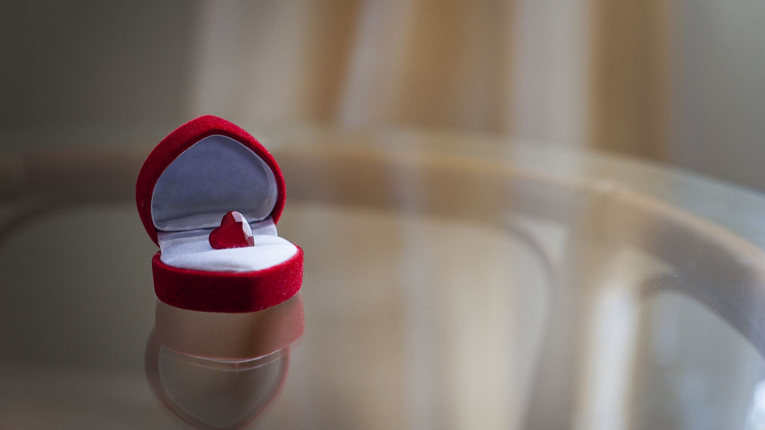
Preparation for Kingdom Marriage
God’s Way
By FollowGod Ministries

Slide 2
God’s way
Vs.
World’s way
World
Identify what you want in a spouse. Explore to determine who has that. Choose the one that does or run from the one that doesn’t
Emphasis on self. The individual wants and desires
The person chooses
Overemphasis on the other individual
Person leaning on limited, stained understanding

Slide 3
God’s way vs. World’s way (cont’d)
Gods Way
Person allows for God to reveal who their spouse is. Walk authentically in who God created you to be. Allow the other person be who God created them to be. Become a triple stranded cord that cannot be easily broken.
Emphasis is on God’s wants and desires
God chooses
Focus on God given identities allowing space and opportunity to be one’s true self and acceptance of another
God leads

Slide 4

Preparation for Kingdom Marriage Error
Focused on one person in relation to another
How you all interact with one another
How you will share responsibilities with each other
Managing each others needs and desires
In Kingdom marriage preparation, we trust the other person to God, and we allow God to prepare us as an individual

Slide 5
3 steps to Kingdom Spouse preparation
Heal
Heal yourself
Heal
Heal from your past relationship
Nurture
Nurture new spouse and relationship

Slide 6

Step 1 Heal Yourself
It is important that you enter into your new relationship healed and whole. Identity in Christ firmly established.
Dangers:
They will have to complete your healing. i.e. constant reassurance, validation, building of self esteem, confidence
You will become what you believe they want you to become
You will adopt what you feel a man or woman wants and become that and will forever be a performer

Slide 7

How to Heal
Invite the Lord into to identify and heal the broken areas of your life as though your life depends on it. It does.
How?
Spend time with the Lord
Read books. Reflect.
Read articles on issues you need to work on (control, fear, emotional intelligence, forgiveness)
Journal. Journal prompt-the truth about myself is…
Read scripture. Research scripture on …Reflect
*Always invite the Lord to this process. If you don’t hear the holy spirit speak, begin writing

Slide 8

How to Heal (cont’d)
Establish new identity
Consider
Who do I want to be? How do I want to show up in the
world?
Ex: someone who loves, fearless, has a gentle quiet spirit, not reactive, calm, confident
What do I have to do to become that?
Ex: Research, remove noise, speak up, challenge others
Look for opportunities to apply daily.
Ex: Change routine, engage in conversations with others, increase interaction with others

Slide 9
Step 2 Heal from your past relationship
Why?
To address issues that may have impacted you and assist further with healing
Do not want to present as one who is still in recovery from last relationship and is still attached. Could scare off out of fear open wounds will bleed on them
Do not want to display a victim mentality that is hyper focused on what they did to you. May give off the wrong impression
Identify Issues
Forgive
Seek Resolve

Slide 10

How to Heal from Past Relationship
1. Write down all of the flaws in the relationship and how it made you feel.
Examples:
Never initiated conversations, spoke down to you. Left feeling not smart.
Didn’t take you out on dates. Made you feel undesirable. Was mean/rude to you, insulted you. Small and unworthy of respect
Didn’t want to have sex with you. Made you feel not sexy, undesirable
2. Evaluate feelings. Do you see a pattern that could lead to low self esteem, insecurities?
3. Address/repair insecurities. Asses whether you honestly feel that way about yourself or was this just the way they made you feel. Change what you need to, discard what is not needed

Slide 11

How to Heal from past relationship (cont’d)
Dangers of not healing from past relationship
1. Overcompensate for insecurities in new relationship.
  Can come off aggressive, combative
  Performer
2. Become dismissive, blind to partners needs
3. Can appear unstable, inconsistent and break down

Slide 12

How to Heal from past relationship (cont’d)
Apply what you did for yourself to ex:
Write down all of the ways you may have made your partner feel negative. What did you do and how did it make them feel
Evaluate list of feelings and know that they also are left with brokenness and insecurities they have to overcome as well
Acknowledge both of your errors in the relationship.
Forgive, cast over to Jesus. Ask Jesus to help move you into further levels of forgiveness

Slide 13
How to Heal from past relationship (cont’d)
Grieve
Grief is the emotional process of coping with the loss of a loved one. The grieving process can include:
Emotions: Shock, numbness, sadness, denial, despair, anger, anxiety, depression, guilt, and relief
Thoughts: Disbelief, confusion, and trouble concentrating
Physical feelings: Tight or heavy throat or chest, sick to your stomach, dizziness, headaches, muscle weakness or tension, and pain
5 stages
Denial- refuse to accept
Anger- blaming/ anger self, others
Bargaining- what is, if only- yourself/ God
Depression- sadness, hopelessness
Acceptance- no longer struggle or deny loss. Celebrate
*You may need to grieve your relationship in different ways. Explore what aspects you need to grieve
grieving process - Google Search
Use multiple tools
Family/close friends
Grief counselors
Grief support groups
Pastors
Doctors

Slide 14

Step 3: Prepare to Nurture New Spouse & Relationship
How?
Part 1
Refer to Step 2. Don’t do that. Do the opposite. Pour into them what you want to be poured out
Encourage, support, uplift, give words of affirmation, highlight the good
Always turn all negative emotions and energies to God to resolve first to give strategy of approach if still needed
Treat like child recognizing each word, action can have lifetime detrimental impact. Never insult or disrespect
Be slow to offense. Do not be quick to be defensive. It is not a battlefield. Seek to be on one accord
Imagine your relationship as new land. You want to plant good seeds, water, feed, nurture, connect so that in 20 years you end up with a heavenly, bountiful, beautiful land not a dry and parched wasteland.
This Photo by Unknown Author is licensed under CC BY-SA

Slide 15

Step 3: Prepare to Nurture New Spouse & Relationship (cont’d)
Part 2
MVG’s
Identify Mission, Vision, Goals for relationship, household, family.
Invite the Lord in to assist with this process
Need to know the vision so you can walk in that daily Ex. Religion, family
Men: Important aspect of leadership.
As a woman of God, I know I am to be in submission to my husband. I would like to know what the mission is I am getting under.
Women: He needs to know your vision so he can see if they are compatible and if he needs to make adjustments

Slide 16

Bonus step
Be a safe place
Reside in laughter, joy, peace, harmony and love.
Lighten up and don’t take life too seriously
Energy is transferable. Be the type of person you want to be around

Slide 17
Summary
3 steps to preparing for kingdom Marriage
Heal yourself
Heal from your past relationship
Nurture new spouse and relationship
Begin reflecting and applying today!

Slide 18

Contact Information:
Email: 2023followgod@gmail.com
Connect via social media:
Facebook: https://www.facebook.com/followgod2024/
YouTube: https://www.youtube.com/channel/UCDPr7-KeaSehEolP_23um7w
TikTok: https://www.tiktok.com/@followgod2023
Twitter: https://twitter.com/FollowGod2023
Instagram: https://www.instagram.com/2023folowgod/
Spotify: https://podcasters.spotify.com/pod/show/solo89
If you would like to sew into the ministry feel free:
Cashapp: $FollowGod2023 or Paypal:2023followgod@gmail.com

