Slide 1
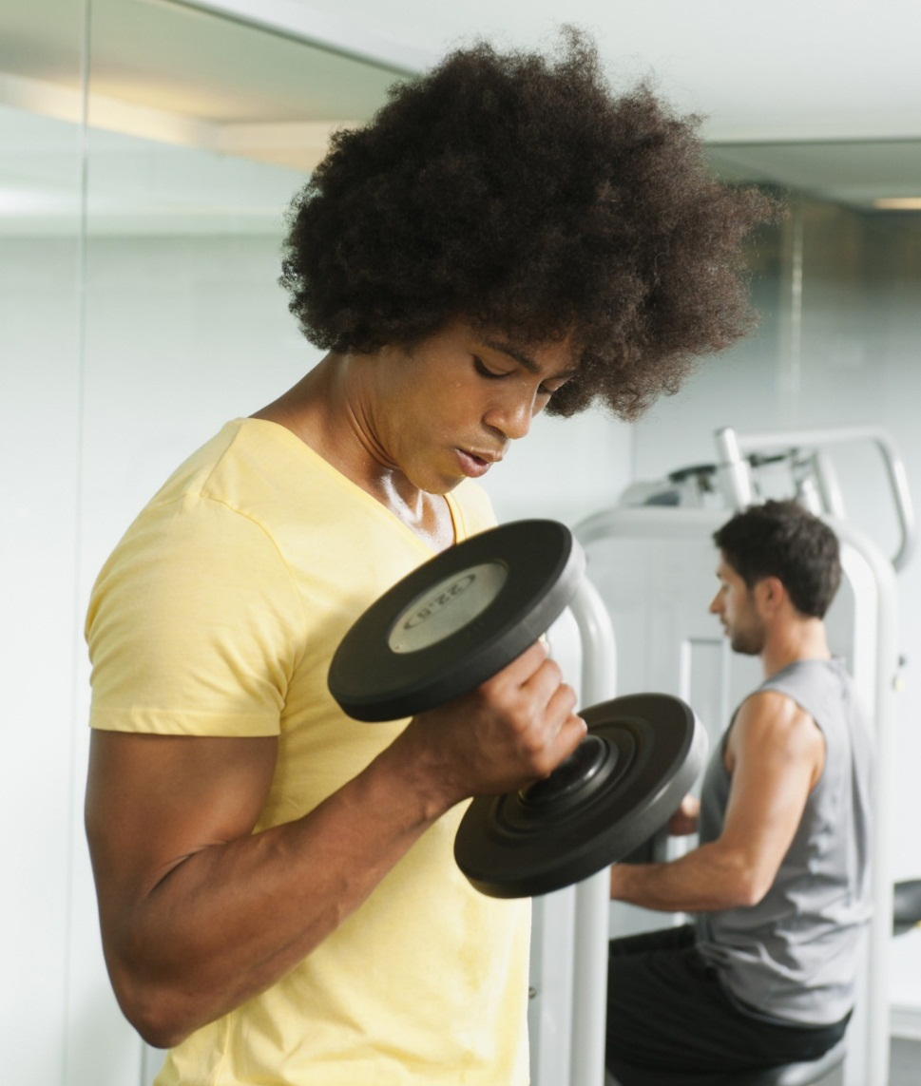


Fitness Under God’s Sovereignty
By Follow god ministries

Slide 2

Foundational scripture
1 Corinthians 6:12 New International Version
“I have the right to do anything,” you say—but not everything is beneficial. “I have the right to do anything"—but I will not be mastered by anything.
Dominated ESV
Mastered NIV
Brought under the control HCSB
But I won't allow anything to gain control over my life. GWT
Power of anything. NHEB
1 Timothy 4:8 For physical training is of some value, but godliness (spiritual training) is of value in everything and in every way, since it holds promise for the present life and for the life to come.
1 Timothy 4:4-5 For everything God created is good, and nothing is to be rejected if it is received with thanksgiving,
Ecclesiastes 9:7 Go, eat your food with gladness, and drink your wine with a joyful heart, for God has already approved what you do.
John 4:34 “My food,” said Jesus, “is to do the will of him who sent me and to finish his work.

Slide 3


My story
I was a health and fitness NUT!!
I worked out excessively and loved it. I craved it. If I didn’t work out, my day was ruined.
I ate very little. After all of the food documentaries, social media videos and conversations with others, my food selection decreased tremendously and there were only few things I would eat.
I had a shelf in my kitchen full of supplements from pre workout, protein powder, vitamins, sea moss, greens and reds powders, creatine, collagen, digestive health pills and magnesium.
I WAS FIT!! In fact, in the best shape of my life. Until I did a deeper dive into the overall state of my health and fitness in every aspect of my being.

Slide 4

Reality strikes
I started feeling overly tired during workouts. I wasn’t able to go as hard as I normally would.
I had an insatiable hunger that let me know my body was not getting the nutrients it needed. Much of the time I felt ravenous. Certainly, preoccupied with food.
I was spending loads of money on supplements and was over caffeinated as I took in the max. amount of caffeine during a workout and monsters throughout the day.
I was cooked after my workout with little to no energy to do what I needed to do for a day.
I couldn’t recover as fast as I used to. I was always breaking down my body and was not giving myself a chance to repair.
I had the façade of health but, in actually, my body was in the worst shape ever. Outside a force to be reckoned with; inside a body crying out for relief.

Slide 5
The making of an idol
I worshipped it and me
They worshipped me
I would view videos on it and documentaries on health and fitness; new gym routines all day.
I would discuss it obsessively.
I began to evangelize health and fitness reporting that it saved me.
I showed off my pristine diet, and fitness level any chance I could get.
I was in love, with me.
People gushed over me as their insecurities would bleed out. They “wished they could be like me.”
They wanted to know more. They wanted help. They flocked for advice and motivation.
They showered me with compliments.
The topic of our conversations: health and fitness.

Slide 6

The Problem
Comparitively, my love for Jesus and the things of God to include identity in Christ, purpose, saving souls, making disciples paled in comparison to my love of fitness.
The state of my mental, emotional well being all overshadowed by my love for fitness
I wasn’t truly healthy and fit as my body showed many signs of struggling to keep up with my restricted diet, rigorous exercise routine and huge amounts of caffeine.
This all contributed to hormones being all out of whack, mood swings, irritability constant fatigue and weariness . A far cry from the fruits of the spirit.
IT HAD BECOME AN IDOL

Slide 7





Question?
Has health and fitness become an idol for you?

Slide 8
Revisiting scripture
Physical training is of some value but when its priority rises above that of your spiritual training- the growth and maturation of your spiritual walk with the Lord, “Houston, we have a problem”.
When we find ourselves, all consumed with it daily, we have to admit that we have come under the power of it and, in fact, enslaved by it.
Most of the Lord’s settings in the bible involved food. They called Him a drunkard and a glutton. He enjoyed it. We are to receive all in thanksgiving. I can’t imagine the Lord refusing food, saying “no, I don’t eat carbs.”
His food was not to maintain a six pack but to do the will of the Father.
This should be our ultimate pursuit as well.

Slide 9
REFLECTION
Is your health and fitness routine conducive, supportive of you completing the will of the Father?
We are to go after Jesus, deny ourselves, take up our cross and follow Jesus.
We are to renounce all we have
We are to lose our life
Jesus should be our highest pursuit

Slide 10
THE NEED TO SURRENDER
Our fitness routines should energize us for the day. It should wake our bodies up, get things moving and allow us to feel better. It should equip us to do what needs to get done for the day.
If we are truly chasing after the Lord, then our health and fitness should be surrendered to the Lord for Him to ensure it is not corrupted and out of order. Too much of anything left unchecked by Jesus can become detrimental.
We should not be giving our all to the gym and left so cooked that we are useless for the building and advancing of God’s kingdom, stepping into our true identity, getting closer with the Lord and evangelizing-saving souls. And this is exactly where the devil wants us.

Slide 11
The Agenda of the enemy
Keep you so preoccupied with building the flesh (that is at enmity with God)
And entangled in the lusts of the flesh, the lust of the eyes and the pride of life which is of this world and he is the ruler of
That your relationship with the Lord and your God given destiny gets lost in the sea of vanity, arrogance, pride as you build not the kingdom of Heaven but the kingdom of darkness by the construction your very own tower of Babel to it highest heights so they can all marvel at you.

Slide 12
What to do
1. Realize that your health and fitness has become an idol.
2. Make pursuing the Lord your highest priority. Get busy with pursuing deeper levels of intimacy with Him, uncovering your identity in Christ and pursuing the plans and purpose for your life as He reveals it.
3. Invite the Lord into help you restructure your health and fitness. The Lord reduced my time in gym, opened up my diet to forbidden foods and removed all supplements. My only source of caffeine-coffee.
Work to keep health and fitness surrendered to the Lord. Remember as disciples, our lives should be marked with the pursuit of Christ not health and fitness.

Slide 13
Reminder
1 Peter 5:8
Be alert and of sober mind. Your enemy the devil prowls around like a roaring lion looking for someone to devour.
John 10:10
The thief comes only to steal and kill and destroy;
John 8:44
You belong to your father, the devil, and you want to carry out your father’s desires. He was a murderer from the beginning, not holding to the truth, for there is no truth in him. When he lies, he speaks his native language, for he is a liar and the father of lies.
Your health and fitness routine is not an adequate weapon against the enemy and will leave you vulnerable and defenseless against the schemes of the enemy

Slide 14
New mindset
I declare I am about my Father’s business! I give the Lord governance over my entire life- even health and fitness. I will have no idols in my life, nor will I worship anyone but Him. I decree that I will no longer be enslaved by health and fitness. I want strength, vitality and energy to perform His will daily. I will allow for a portion of my day, if the Lords leads, to be given over to health and fitness. If ever there is a conflict between my pursuit of Jesus and His plan and purpose for my life and the gym or nutrition, Jesus will always win out. Lord, I will not build myself in such a way nor express it so that I can receive the glory, attention and worship that belongs to you. I put you back in your rightful place as #1 in my life. Physical fitness has no bearing in the spiritual realm. I now seek the things of the spirit. Show me Lord how to honor this temple with movement and nutrition in a way that honors and serves your highest good for me. I come out of agreement with vanity, ego, pride, self worship and arrogance and take on humility and servitude. Lord lead me. Show me the way. In Jesus Name.

Slide 15
Use caution
Warning!
Be careful not to swing the pendulum to the other side.
Sloth, Laziness, Gluttony will not serve you well.
1 Corinthians 9:27
But I discipline my body and keep it under control, lest after preaching to others I myself should be disqualified. I discipline my body like an athlete, training it to do what it should. Otherwise, I fear that after preaching to others I myself might be disqualified.
The body is not to be neglected merely surrendered to the Lord so He can keep it in it’s proper place-under Him.

Slide 16
My current routine
Prayer and gratitude runs daily 35-45 minutes. 15 minutes of pyramid exercises.
No supplements. Coffee only.
Exercise is on the list of things to do in the day, but it is not the priority. If the Lord desires, it can wait until the following day.
I eat clean and light most of the time. I love the way my body feels eating healthy. If I am offered food in love, I take it. When I go out to eat with others, I enjoy myself with a variety of foods.
Being 240 lbs several times through out my adulthood, my goal is simply to live without fear.
I want to live with joy and thanksgiving. I want to live for God, not myself. And when it’s all done, I want to hear “Well done, good and faithful servant.”

Slide 17
Trust God
Lay down your fears before the Lord and trust that as you do, He knows how to keep you.
It will be an adjustment, but freedom is so worth it and its now available to you!
Come out of bondage and run into the arms of Jesus

Slide 18
Summary
Foundational Scripture
My story
Health and Fitness as an idol
The Problem and Solution

Slide 19
Contact Information
Email: 2023followgod@gmail.com
Connect via social media:
Facebook: https://www.facebook.com/followgod2024/
YouTube: https://www.youtube.com/channel/UCDPr7-KeaSehEolP_23um7w
TikTok: https://www.tiktok.com/@followgod2023
Twitter: https://twitter.com/FollowGod2023
Instagram: https://www.instagram.com/2023folowgod/
Spotify: https://podcasters.spotify.com/pod/show/solo89
If you would like to sew into the ministry, feel free:
Cashapp: $FollowGod2023 or Paypal:2023followgod@gmail.com

