Slide 1
Prayer
Jeremiah 29:12-13
“Then you will call on me and come and pray to me, and I will listen to you. You will seek me and find me when you seek me with all your heart.”

Slide 2
No Formula
There is no formula to prayer. The Lord wants to speak to you and wants to hear from you. It is a two-way conversation. He desires to hear from you .
Consider the way He speaks to Jeremiah as the Lord declares the word. He spoke over Him as a prophet of nations, addresses his fears, teaches him about his seer prophetic gift, provides instruction and prepares him for the journey he will undertake.
God is not a distant magic genie in the clouds or an entity that gives orders and expects you to respond robotically. No, our loving Father desires to be in relationship with you. He lovingly speaks to Jeremiah, Moses, Abraham, Elijah. He speaks to Saul on His way to Demascus and asks why he persecutes Him. He talks to Annaias and instructs him, addresses his fears and tells him of his plans. This is the way of our Lord.

Slide 3
Does He speak to you this way? Does this describe your relationship with your Father God, Your Lord and friend and brother, His spirit, your comforter?
If not,
ask yourself why?

Slide 4
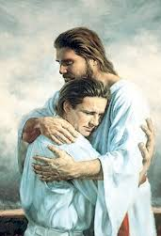
“I love those who love me, and those who seek me diligently find me.”
Prov. 8:17
We were never meant to live this life confused, lost, in pain, unhealed, or alone. We were made in the image of God.
God desires us not to figure out the plans. He has one for us and it is good! He is not trying to trick us to solve riddles or walk through hard mazes. No, He has a path laid out that He desires us to take.
Set your whole heart, mind and soul on loving Him. Seek him diligently with all you have. Allow Him time and space to reveal Himself to you and attune your ear to His voice and watch Him show Himself strong and mighty in your life and welcome you into family, friendship, partnership, covenant and love.

Slide 5
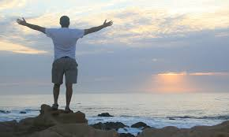
Incorporate the many ways of prayer.
What way works for you?
Journal
Take a walk
Go to the beach
Traditional- knees, laying prostrate, sitting in a quiet space
On a surfboard in the depths of the ocean.
Jesus is simply delighted with the invitation.
Go ahead. Go after Jesus.

