Slide 1
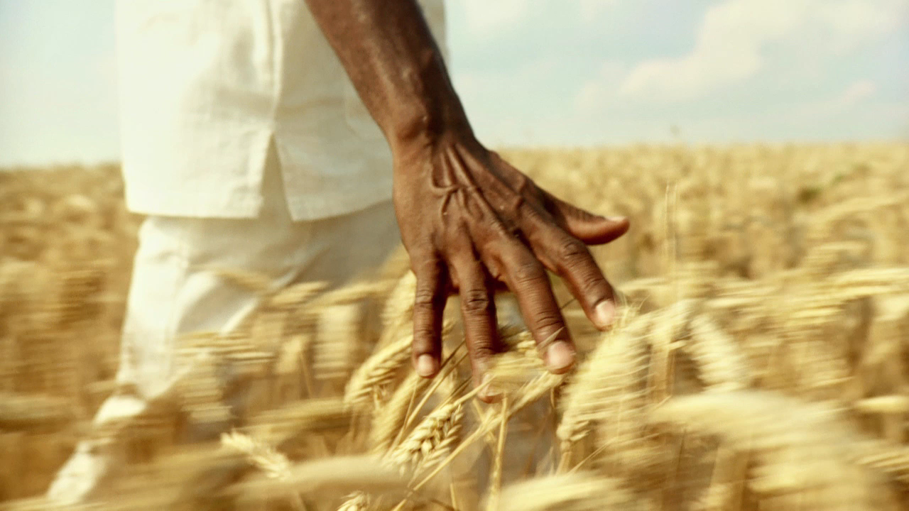
Sacrifice and Release
Hebrews 12:1 says, “Wherefore seeing we also are compassed about with so great a cloud of witnesses, let us lay aside every weight, and the sin which doth so easily beset us, and let us run with patience the race that is set before us.”

Slide 2
Identifying the Weight?
What is the weight that so besets you? What is holding you back from giving your whole soul to Jesus Christ?
Release it today. Let it go!
People often do not want to come to Christ or find themselves at odds with Jesus because they feel as though He desires to take what they hold so dear to them.

Slide 3

My darling child,
I love you so much. I desire not to take from you, but to release the burdens that keep you from enjoying the fullness of what I offer. I offer you peace, joy love and rest.
What you are holding onto is blocking you from living the abundant life I offer.
Dear child, don’t you know that I am for you and that I love so much. I desire good things for you. I want to protect you from things that don’t serve you.
I know you don’t understand why I am asking you to release this very thing from your life, but if you can trust me, I will show you there is better waiting on the other side of your faithful move.
Release it and watch my hand move in your life. Watch my very breath blow over your entire land. Come follow me. Take the next step I am asking you to take and then I will show you the next one. Walk with me into your destiny.
The decision is yours to make. I will not force you.
As your Father, I only ask that you trust me.
Its ok. I got you. I am right here with you. Take the step.
Love, Your Father.

