Slide 1
WORSHIP
If it is anything other than Jesus Christ, you need to repent.
We have all been guilty of falling into the trap of being “saved” by another and/or worshipping something or someone in this world.
This is out of order. Only Jesus saves. Only Jesus delivers. Only Jesus paid the cost for your very life. Only Jesus.
Be sure to keep the Lord, your God, in His proper place. Fight to protect His place above ALL. All means all.
Matthew 10:37-38
Anyone who loves his father or mother more than Me is not worthy of Me; anyone who loves his son or daughter more than Me is not worthy of Me; and anyone who does not take up his cross and follow Me is not worthy of Me.
What have you put before the Lord?
Remove the idols in your life. The false gods of this world and give God your full worship.
Join the language of heaven as the cry goes out day and night:
“Holy, holy, holy, Lord God Almighty, who was, and is, and is to come!”
He is worthy of your worship.
Pour it out Him.
What do you worship?
What or whom do you devote your time to?
What do you admire, adore, testify/witness to?
What do you tell others saved your life?

Slide 2
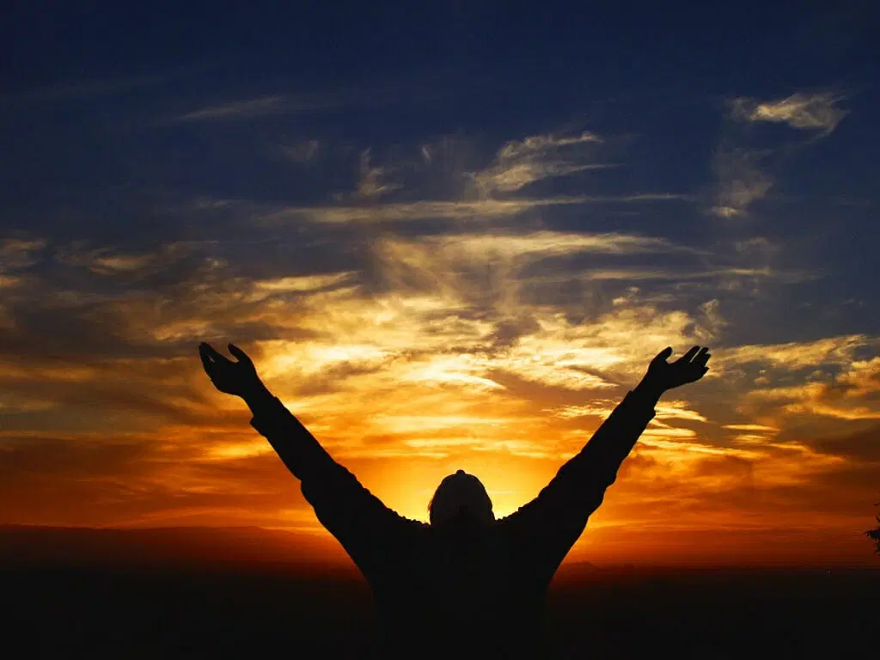
Sing to the Lord, all the earth; proclaim his salvation day after day. ²⁴ Declare his glory among the nations, his marvelous deeds among all peoples.
²⁵ For great is the Lord and most worthy of praise; he is to be feared above all gods. ²⁶ For all the gods of the nations are idols, but the Lord made the heavens. ²⁷ Splendor and majesty are before him; strength and joy are in his dwelling place.
²⁸ Ascribe to the Lord, all you families of nations, ascribe to the Lord glory and strength. ²⁹ Ascribe to the Lord the glory due his name; bring an offering and come before him. Worship the Lord in the splendor of his holiness. ³⁰ Tremble before him, all the earth! The world is firmly established; it cannot be moved.
³¹ Let the heavens rejoice, let the earth be glad; let them say among the nations, “The Lord reigns!”
HALLELUAH!
PRAISE HIS HOLY NAME
1 CHRONICLES 16:23-31

Slide 3
Give God All Your Worship!!!
Sing to Him
Praise Him (Express admiration and adoration)
Humble yourself before Him
Give Thanks to Him
Spend time with Him soaking in His goodness
Acknowledge and marvel at His great works in nature, in the world in your very own life
Direct your focus and attention toward the Lord and open your heart to receive Him
Offer your body to Him as a living sacrifice

